Slide 1

Predicting House Prices
A Supervised Learning Capstone Project by Paul Schmidt
https://github.com/paulbenschmidt/predicting-house-prices

Slide 2
Outlining the Presentation
I. Introduction to House Prices
A. Context on Housing Market
B. Information on Specific Dataset
II. Presenting the Research Question
A. Need and Solution
B. Method of Testing
III. Addressing the Research Question
A. Feature Engineering
B. Model Tuning
C. Selecting our Final Model
IV. Conclusion: Model’s Relevance

Slide 3
I. Introduction to House Prices
II. Building a Case for the Research Question
III. Addressing the Research Question
IV. Conclusion: Model’s Relevance

Slide 4
I. Introduction to Housing Prices Context on Housing Market
For those looking to buy or sell in the housing real estate market, it can be difficult to accurately predict a house’s worth, reducing the process to an arbitrary decision.
For the buyer:
At risk of purchasing an overpriced home
Unable to tell when a home is underpriced and, therefore, worth considering
For the seller:
At risk of selling their home for a price less than its actual value
Unable to tell if their listing is overpriced
In light of this, our goal is to statistically derive this house price in order to empower both the buyer and the seller in their market.

Slide 5
I. Introduction to Housing Prices Information on Dataset
The dataset used for this project was gathered by Dean De Cock, professor of Truman State University, and is available on Kaggle under the name “House Prices: Advanced Regression Techniques.”
De Cock organized this dataset as a result of only have a limited, outdated dataset on Boston housing prices
After meeting with the Assessor and Deputy Assessor of the Ames City Assessor’s Office, they allowed De Cock access to the data – an Excel file with an original 113 variables. Roughly 30 features were removed from the dataset that required special knowledge or that were previously calculated.
The final product was a 81x1460 dataset on the house prices of Ames, Iowa.

Slide 6
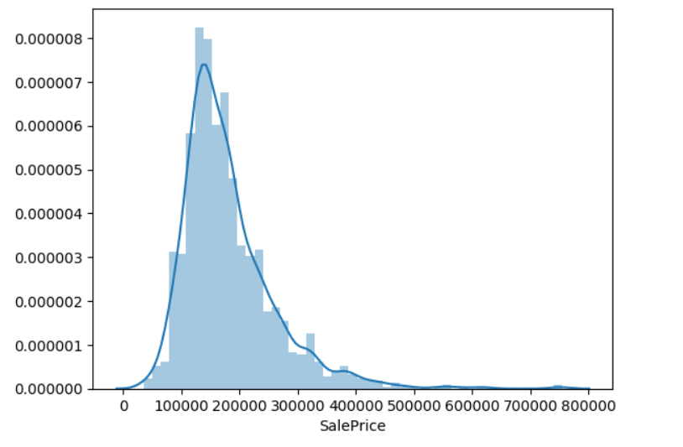
I. Introduction to Housing Prices Information on Dataset
Using a dataset with information on 1460 residential homes in Ames, Iowa, our goal is to calculate the continuous variable of a house’s price by:

Slide 7
I. Introduction to Housing Prices Information on Dataset
Using a dataset with information on 1460 residential homes in Ames, Iowa, our goal is to calculate the continuous variable of a house’s price by:
Exploring the 79 explanatory variables
Continuous:
“YearBuilt”
“LotArea”
“GrLivingArea”
Categorical:
“Neighborhood”
“CentralAir”
“GarageQual”
SalePrice - the property's sale price in dollars (target variable)
MSSubClass: The building class
MSZoning: The general zoning classification
LotFrontage: Linear feet of street connected to property (259 NaN values)
LotArea: Lot size in square feet
Street: Type of road access
Alley: Type of alley access (1369 NaN values)
LotShape: General shape of property
LandContour: Flatness of the property
Utilities: Type of utilities available
LotConfig: Lot configuration
LandSlope: Slope of property
Neighborhood: Physical locations within Ames city limits
Condition1: Proximity to main road or railroad
Condition2: Proximity to main road or railroad (if a second is present)
BldgType: Type of dwelling
HouseStyle: Style of dwelling
OverallQual: Overall material and finish quality
OverallCond: Overall condition rating
YearBuilt: Original construction date
YearRemodAdd: Remodel date
RoofStyle: Type of roof
RoofMatl: Roof material
Exterior1st: Exterior covering on house
Exterior2nd: Exterior covering on house (if more than one material)
MasVnrType: Masonry veneer type - (8 NaN values)
MasVnrArea: Masonry veneer area in square feet - (8 NaN values)
ExterQual: Exterior material quality
ExterCond: Present condition of the material on the exterior
Foundation: Type of foundation
BsmtQual: Height of the basement (37 NaN values)
BsmtCond: General condition of the basement (37 NaN values)
BsmtExposure: Walkout or garden level basement walls (38 NaN values)
BsmtFinType1: Quality of basement finished area (37 NaN values)
BsmtFinSF1: Type 1 finished square feet
BsmtFinType2: Quality of second finished area (if present) (37 NaN values)
BsmtFinSF2: Type 2 finished square feet
BsmtUnfSF: Unfinished square feet of basement area
TotalBsmtSF: Total square feet of basement area
Heating: Type of heating
HeatingQC: Heating quality and condition
CentralAir: Central air conditioning
Electrical: Electrical system (1 NaN value)
1stFlrSF: First Floor square feet
2ndFlrSF: Second floor square feet
LowQualFinSF: Low quality finished square feet (all floors)
GrLivArea: Above grade (ground) living area square feet
BsmtFullBath: Basement full bathrooms
BsmtHalfBath: Basement half bathrooms
FullBath: Full bathrooms above grade
HalfBath: Half baths above grade
Bedroom: Number of bedrooms above basement level
Kitchen: Number of kitchens
KitchenQual: Kitchen quality
TotRmsAbvGrd: Total rooms above grade (does not include bathrooms)
Functional: Home functionality rating
Fireplaces: Number of fireplaces
FireplaceQu: Fireplace quality (690 NaN values)
GarageType: Garage location (81 NaN values)
GarageYrBlt: Year garage was built (81 NaN values)
GarageFinish: Interior finish of the garage (81 NaN values)
GarageCars: Size of garage in car capacity
GarageArea: Size of garage in square feet
GarageQual: Garage quality (81 NaN values)
GarageCond: Garage condition (81 NaN values)
PavedDrive: Paved driveway
WoodDeckSF: Wood deck area in square feet
OpenPorchSF: Open porch area in square feet
EnclosedPorch: Enclosed porch area in square feet
3SsnPorch: Three season porch area in square feet
ScreenPorch: Screen porch area in square feet
PoolArea: Pool area in square feet
PoolQC: Pool quality (1453 NaN values)
Fence: Fence quality (1179 NaN values)
MiscFeature: Miscellaneous feature not covered in other categories (1406 NaN values)
MiscVal: $Value of miscellaneous feature
MoSold: Month Sold
YrSold: Year Sold
SaleType: Type of sale
SaleCondition: Condition of sale

Slide 8
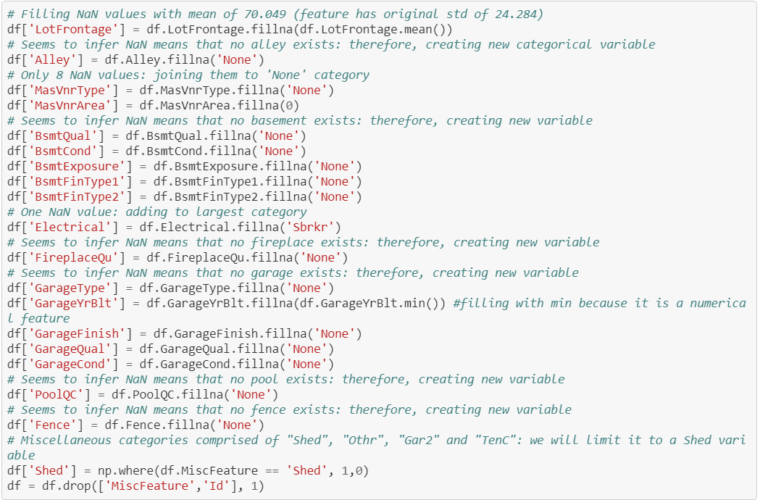
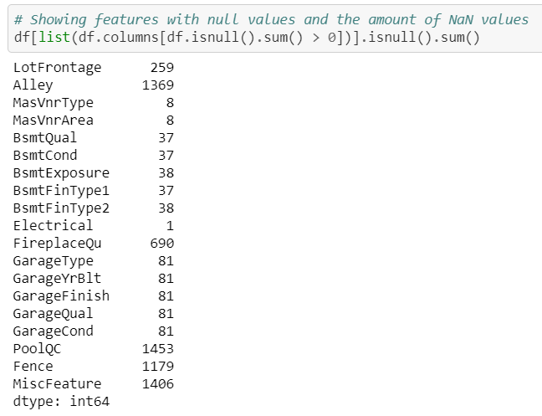
I. Introduction to Housing Prices Information on Dataset
Preparing the data by addressing missing values:

Slide 9
II. Presenting the Research Question
I. Introduction to House Prices
III. Addressing the Research Question
IV. Conclusion: Model’s Relevance

Slide 10
II. Presenting the Research Question The Need and Solution
The Need
Those lacking industry experience in real estate are at risk of buying or selling mispriced properties at a loss.
When given a complete list of the house specifications, the buyer/seller should have statistical confidence in their desired house price point.
The Solution
By creating a model that uses a wide variety of features, we will be able to calculate the house price.
The seller may input house specifications specifications and have it return an estimated selling price.
The buyer may assess deals based on the house specifications and determine whether a listing is over- or under-priced.

Slide 11
II. Presenting the Research Question The Method of Testing
To effectively calculate the continuous variable house price, we will test and create various models, assessing their accuracy via train-test split and cross-validation.
Goal: In order to provide the buyer/seller with a consistent, accurate model, we will attempt to create a model with at least 85% accuracy.
Regression Methods Used:
Linear Multivariable Regression (OLS)
KNN Regression
Ridge Regression
Lasso Regression
Random Forest Regressor (Ensemble)
Support Vector Regressor

Slide 12
III. Addressing the Research Question
I. Introduction to House Prices
II. Presenting the Research Question
IV. Conclusion: Model’s Relevance

Slide 13
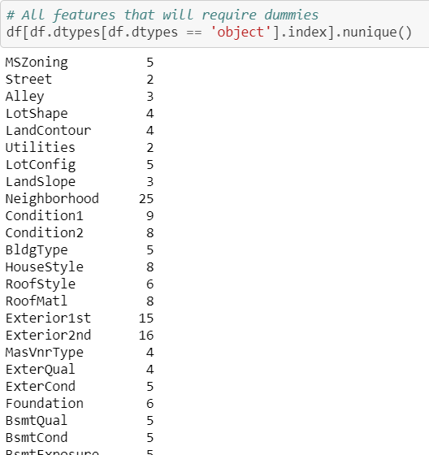
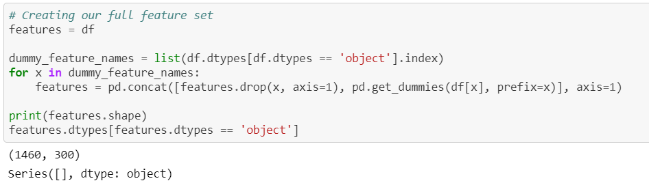
III. Addressing the Research Question (Feature Engineering Stage 1) Preparing the Basic Feature Set
Non-integer variables: 42
Creating a dummy set with new, basic features
(300 features x 1460 houses)

Slide 14
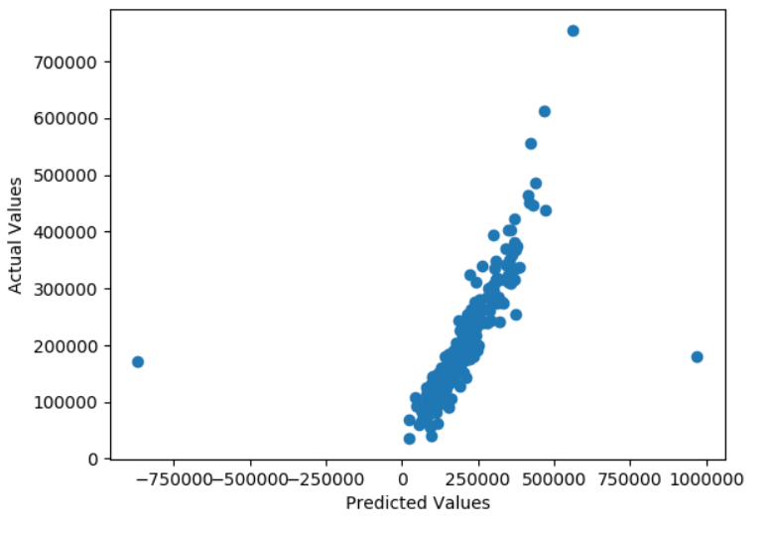
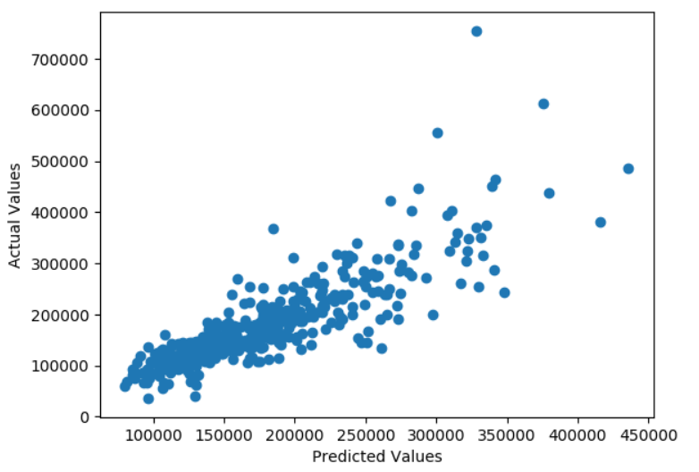
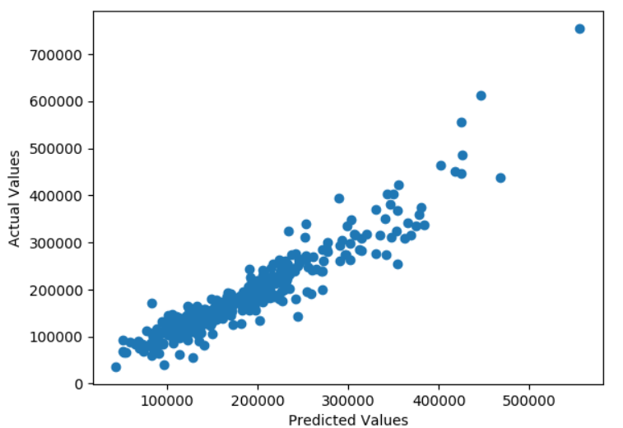
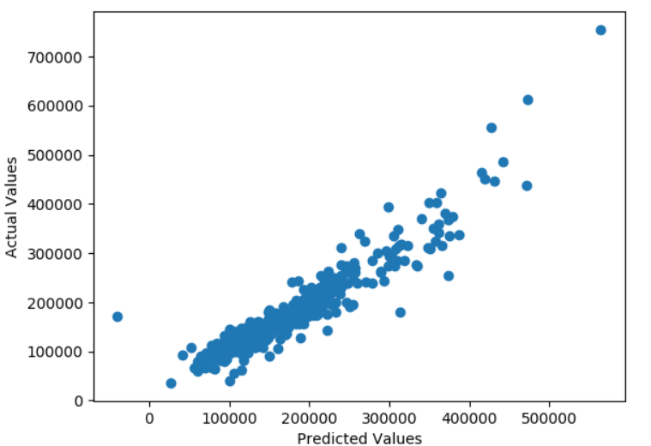
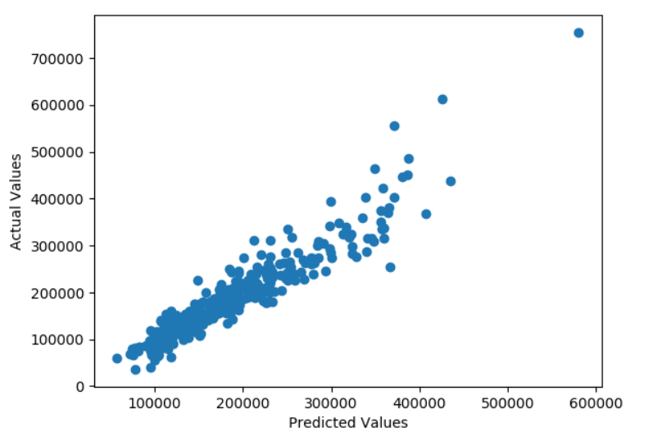
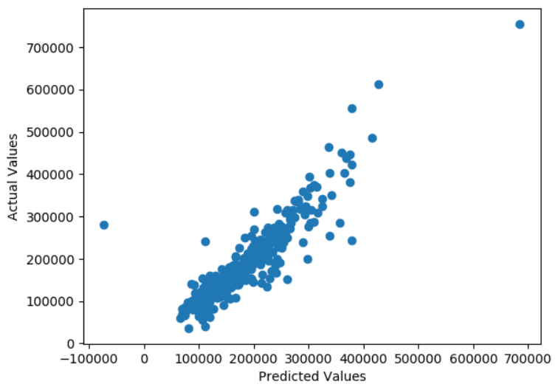
III. Addressing the Research Question (Modeling Stage 1) Modeling the Basic Feature Set
Multivariable Linear Regression
Score: 33.81%
KNN Regression
Score: 70.21%
Ridge Regression
Score: 88.35%
Lasso Regression
Score: 87.88%
Random Forest Regressor
Score: 88.13%
Support Vector Regression
Score: 81.31%

Slide 15
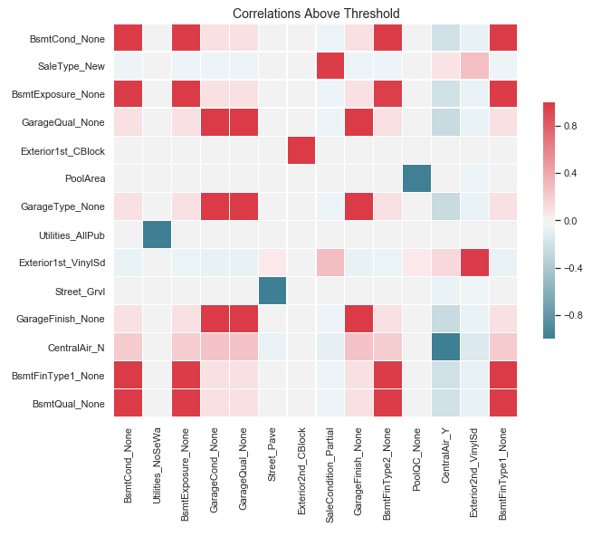
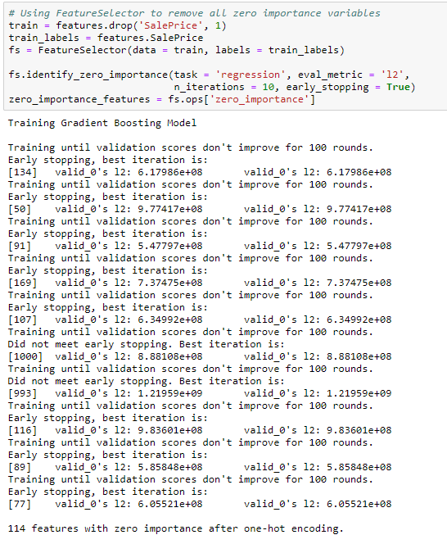
III. Addressing the Research Question (Feature Engineering Stage 2) Refining Our Features with FeatureSelector
Removing perfectly correlated variables
Shape: (1460, 295)
Removing all zero-importance variables with FeatureSelector
Shape: (1460, 181)

Slide 16
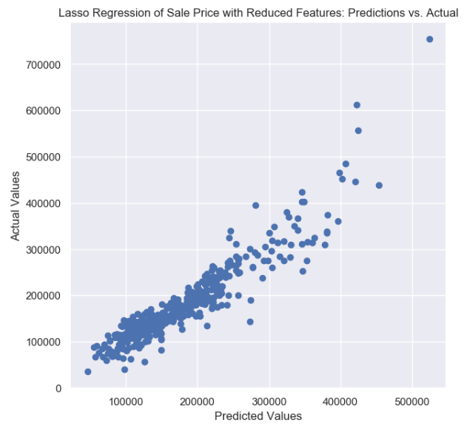
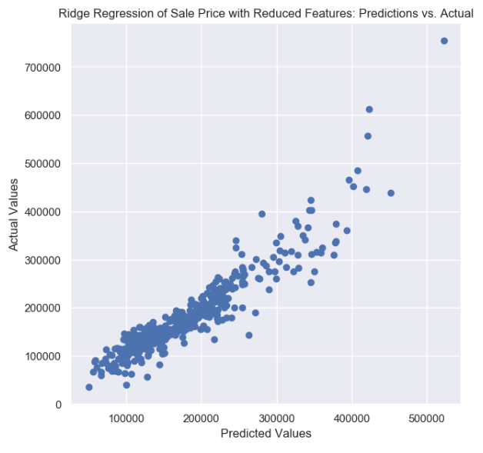
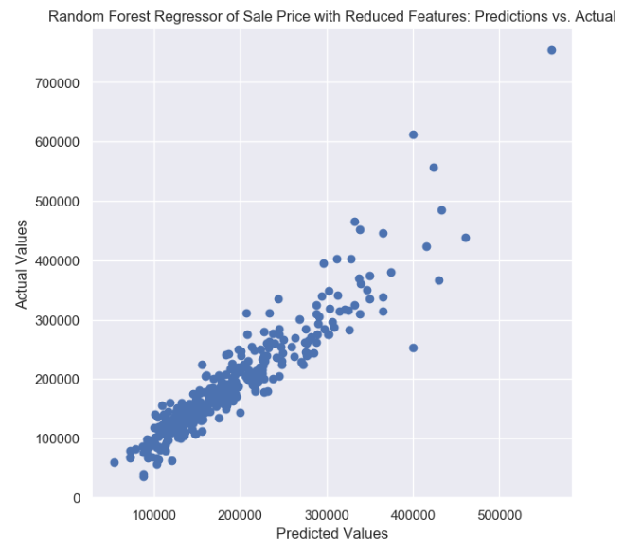
III. Addressing the Research Question (Modeling Stage 2) Modeling Reduced Feature Set
Ridge Regression
Score: 86.80%
Former: 88.35%
Lasso Regression
Score: 86.57%
Former: 87.88%
Random Forest Regressor
Score: 87.30%
Former: 88.13%

Slide 17
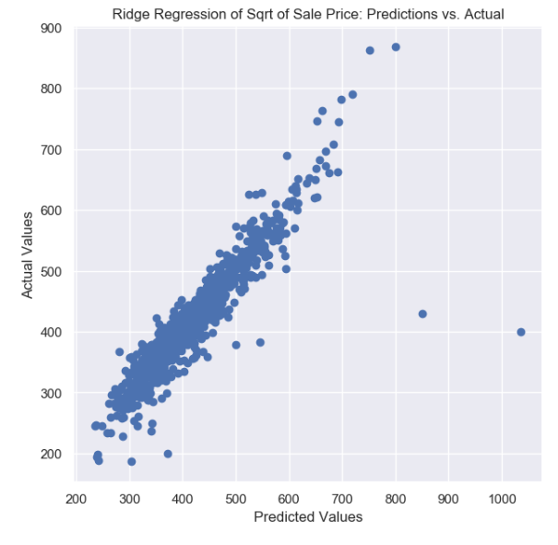
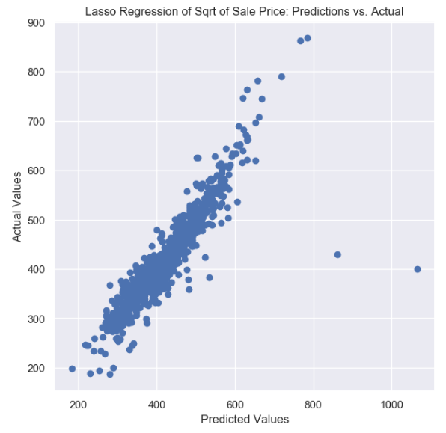
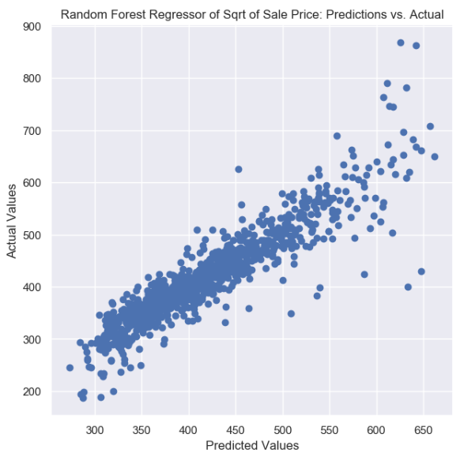
III. Addressing the Research Question (Modeling Stage 3) Modeling Reduced Feature Set and Adjusted Target
Ridge Regression
Score: 83.27%
Former: 86.80%
Lasso Regression
Score: 81.89%
Former: 86.57%
Random Forest Regressor
Score: 83.45%
Former: 87.30%

Slide 18
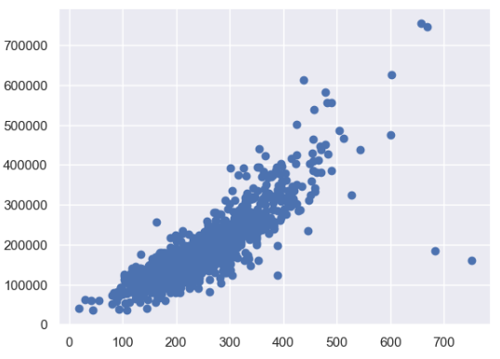
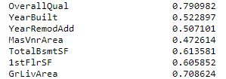
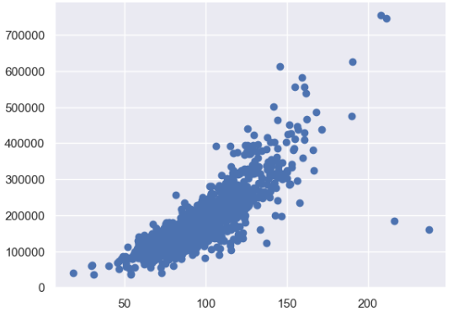

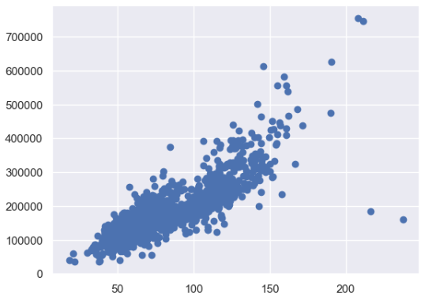
III. Addressing the Research Question (Feature Engineering Stage 3) Creating New Features
np.sqrt(GrLivArea) * OverallQual
np. sqrt(GrLivArea*OverallQual)
np.sqrt((GrLivArea*OverallQual)
(1 + features.ExterQual_TA)
Assessing feature correlation

Slide 19
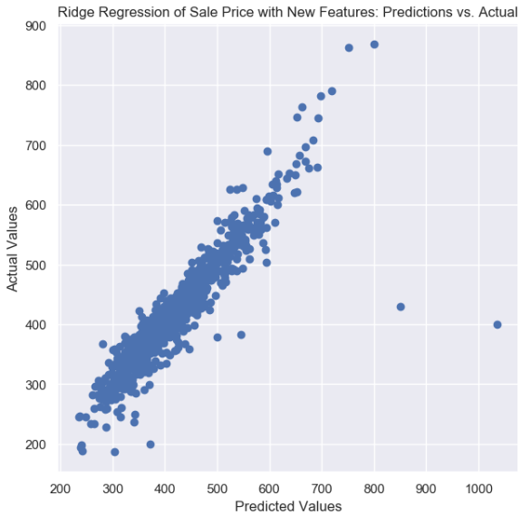
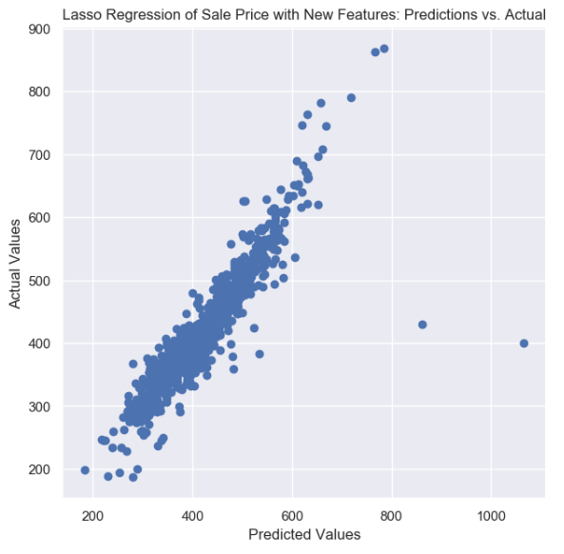
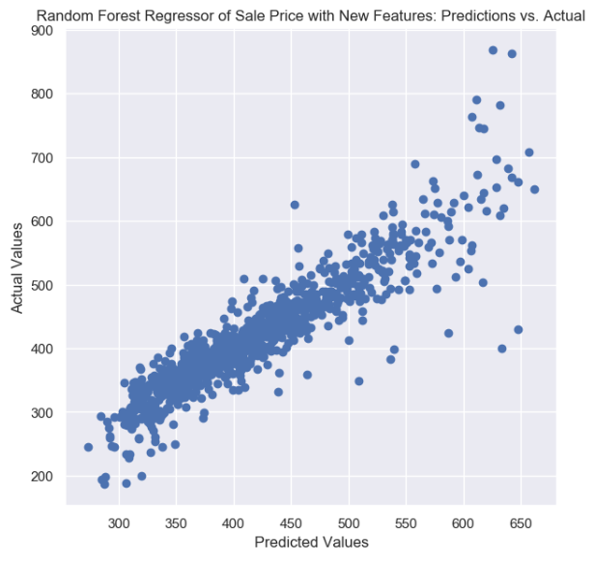
III. Addressing the Research Question (Modeling Stage 4) Modeling Feature Set with New Features
Ridge Regression
Score: 83.72%
Optimal: 88.35%
Lasso Regression
Score: 81.87%
Optimal: 87.88%
Random Forest Regressor
Score: 83.45%
Former: 88.13%

Slide 20
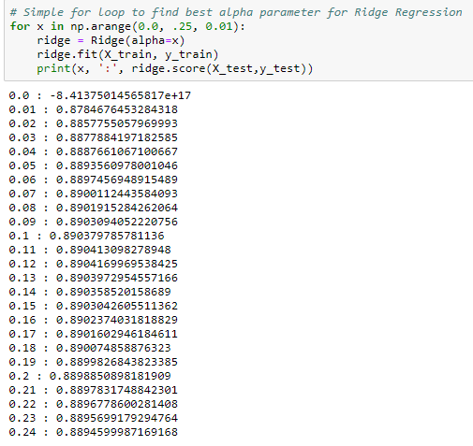
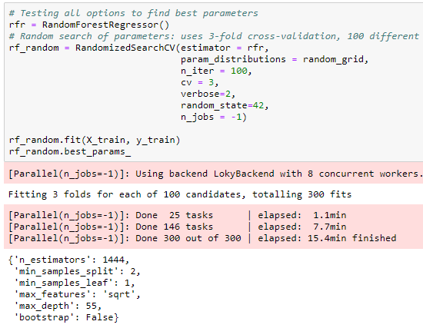
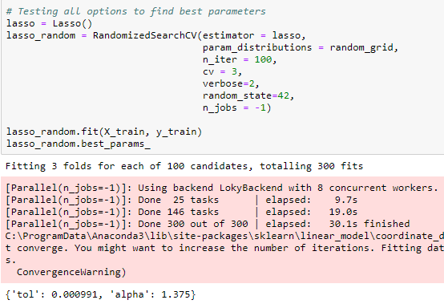
III. Addressing the Research Question (Modeling Stage 5) Tuning Our Models
Ridge Tuning
Lasso Tuning
Random Forest Tuning
Score: 89.04%
Former: 88.35%
Score: 89.39%
Former: 88.13%
Score: 88.06%
Former: 87.88%

Slide 21

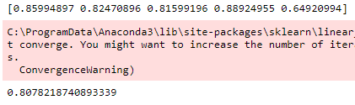

III. Addressing the Research Question (Modeling Stage 5) Cross-Validating Our Tuned Models
Ridge CV
Mean: 81.08%
High variance
Lasso CV
Mean: 80.78%
High variance
Random Forest CV
Mean: 85.36%
Lower variance!

Slide 22
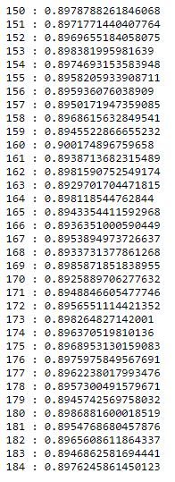
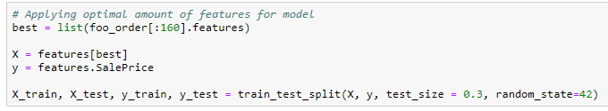
III. Addressing the Research Question (Feature Engineering Stage 4) Limiting Features with RFR Feature Importance
After viewing the accuracy across the spread of features, we dialed in to the range of 150-184 to find the best model with the least features

Slide 23
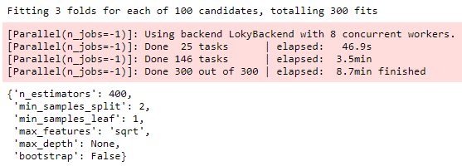


III. Addressing the Research Question (Modeling Stage 4) Random Forest Regression Tuning
Finding optimal parameters
Assessing accuracy with parameters on train-test
Cross-Validation assessment
Model Conclusions:
Overall accuracy dropped slightly (from 89.39% to 88.97%).
CV mean score improved (from 85.36% to 86.89%) as a result of the
Reduced feature set (300 to 160) reduced overfitting
Decrease in variance lead to more consistent scores

Slide 24
IV. Conclusion: Model’s Relevance
I. Introduction to House Prices
II. Presenting the Research Question
III. Addressing the Research Question

Slide 25
IV. Conclusion: Model’s Relevance Random Forest Regressor
Strengths
Weaknesses
Consistently outperforms all other models in most cases
Potential to perform above 90% accuracy
Low variance in cross-validation
Does not generate as many significant outliers in predictions
Provides less insight into the model reasoning
Relatively slower model when compared to Ridge or Lasso
Conclusion: Being above our aforementioned goal of 85%, we may confidently provide the home buyer or seller in Ames, Iowa, with a model that would enable them to make informed pricing decisions.

Slide 26
Questions & Answers
https://github.com/paulbenschmidt/predicting-house-prices

